Slide 1

The Polynomial Hierarchy
Instructor: Kuan Cheng

Slide 2
Generalization of P, NP, coNP

Slide 3
Generalization of P, NP, coNP

Slide 4
Generalization of P, NP, coNP

Slide 5
Generalization of P, NP, coNP

Slide 6
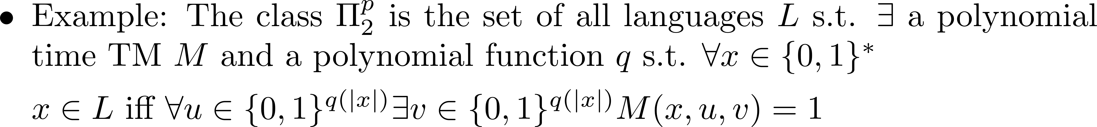
Generalization of P, NP, coNP

Slide 7
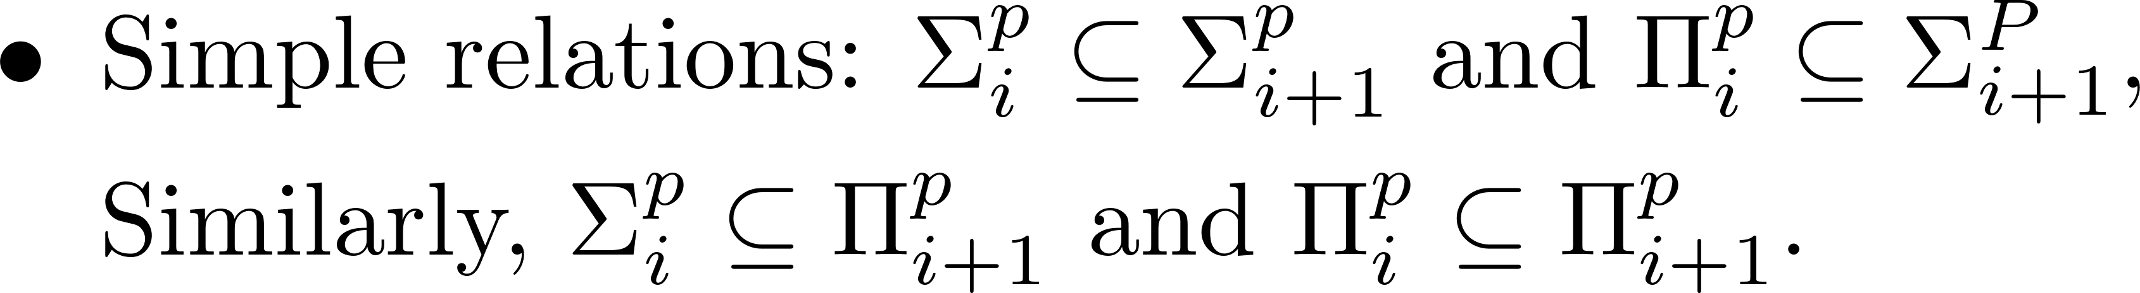
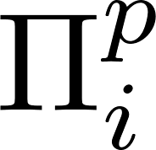
Generalization of P, NP, coNP

Slide 8
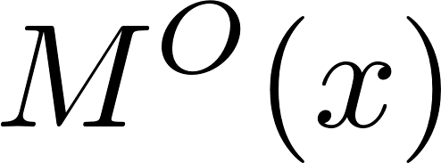
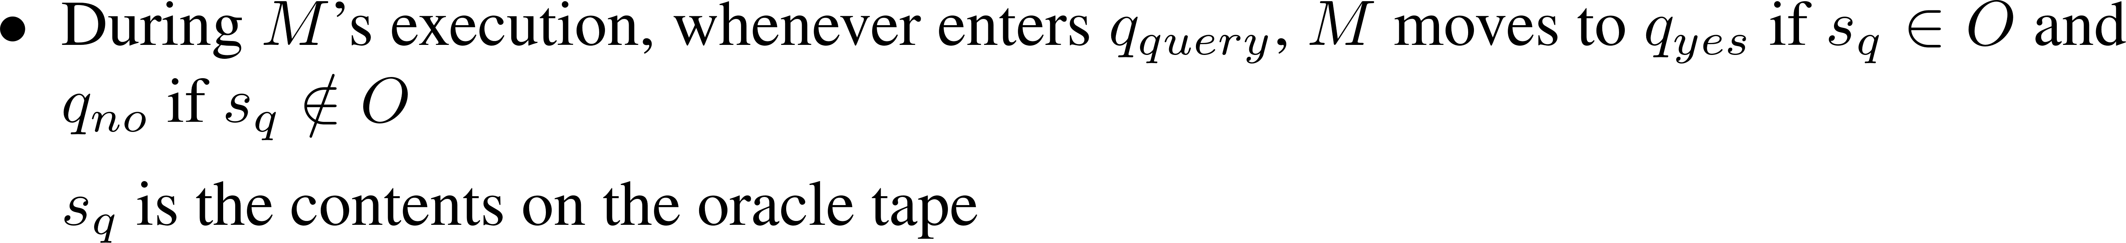
Oracle TMs

Slide 9

The Polynomial Hierarchy

Slide 10
The Polynomial Hierarchy

Slide 11
The Polynomial Hierarchy

Slide 12
The Polynomial Hierarchy

Slide 13
The Polynomial Hierarchy

Slide 14
The Polynomial Hierarchy

Slide 15
The Polynomial Hierarchy

Slide 16
The Polynomial Hierarchy
Not hard to show that PH⊆PSPACE.
Can use the same algorithm for TQBF to decide any language in PH, since the # of quantifiers is a constant (although can be arbitrarily large).
Corollary: If PH does not collapse, then PH is a true subset of PSPACE.
Otherwise TQBF is a PH complete language.
Question: Does P=NP imply P=PSPACE? why?

